Slide 1
IOT EXHIBITION 2020
PROJECT BRATSO

Slide 2
IDEA
3 Axis Arm Robot controlled by Arduino. The arm can be programmed and automatically execute repetitive tasks until a stop command is received, as well as manually operated.

Slide 3
Apparatus
Micro-Controllers (Arduino Mega, NodeMCU ESP8266)
Servo Motors (Tower Pro MG995,Tower Pro SG5010)
Aluminium Robot Arm Clamp Claw
Breadboard
LEDs
LCD Display

Slide 4
Apparatus
Push Buttons
Jumper Wires
Buck Convertor
12V Lead-Acid Battery (Automobile Battery)
470μF Capacitors
330Ω,10KΩ Resistors

Slide 5
Materials
Aluminium Composite Panel (ACP) Sheets
Aluminium Sheet 0.46mm
Truss Head/Hex Head Machine Screws
Soldering Lead
Double Sided Tape

Slide 6
Operation
Manual
Automated
Robot Arm can be manually operated using push buttons.
Robot Arm can automatically execute a pre-recorded sequence of commands.

Slide 7
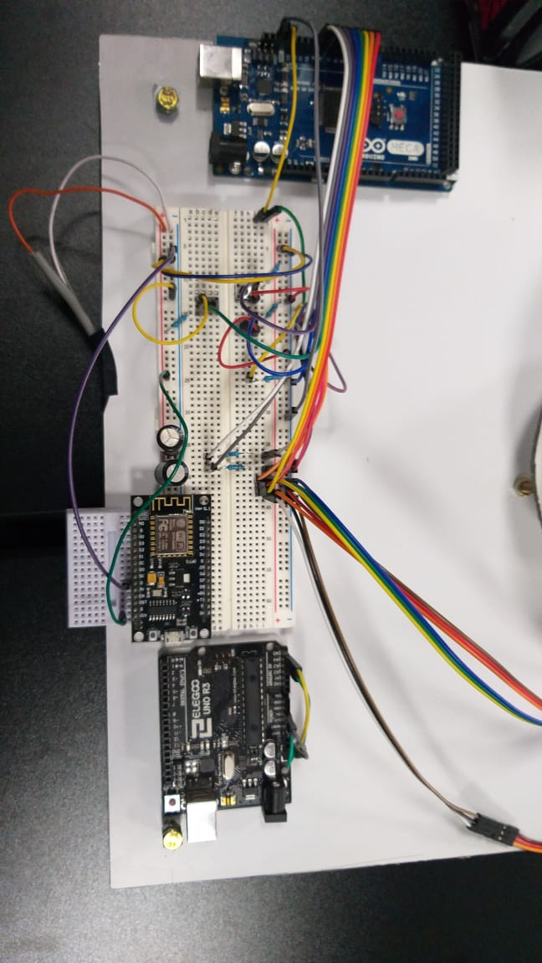
Manual Operation
Anti-Clockwise Rotation
Clockwise Rotation
Motor Selection

Slide 8

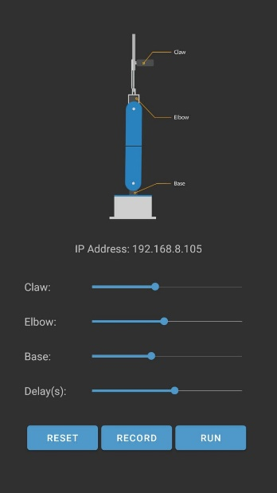
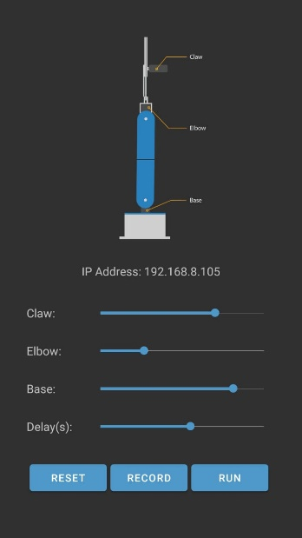
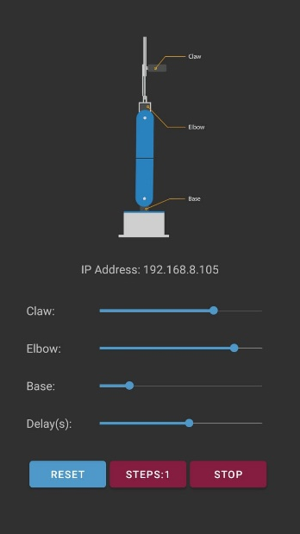
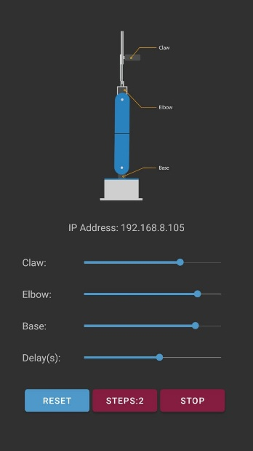

Automated Operation

Slide 9
Problems & Solutions
Maximum Load
Current & Voltage Issues
Range Of Operation
Precision

Slide 10
Maximum Load
The arm can only hold a weight of (83grams) since the claw exerts a considerable amount of resistive torque on the relevant motor. This can be managed by applying a counter weight on the other side of the claw arm. But in our case since the aluminium bracket is smaller it is difficult to set up a counter mechanism.

Slide 11
Current & Voltage Issue
All the servo motors have to be powered up using an external power supply since the power output of Arduino Mega is not sufficient enough for the optimum function of the motors. Furthermore, trying to draw such a large current could damage the micro controller and the USB port.
In this particular case the motors are powered up using an Automobile battery by stepping down the voltage to the required level using a buck convertor.
470μF capacitors are connected in between the VCC and the common ground for a smooth operation.

Slide 12
Range Of Operation
Range of operation can be extended by using lengthier arms but it will affect the stability of the setup. Moreover, the servo motors won’t be able to operate with increased torques.

Slide 13
Precision
The arm cannot deliver an object precisely to a pre-recorded position this is due to the play of the motor. This condition can be avoidable by using baller bearings to rotating joints.

Slide 14
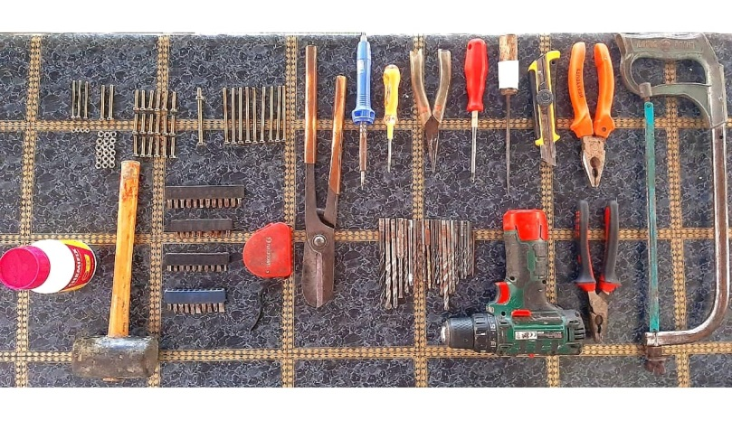
Tools

Slide 15

THANK YOU !

